Slide 1
Our Teacher – Prabhupad (1896-1977)

Slide 2
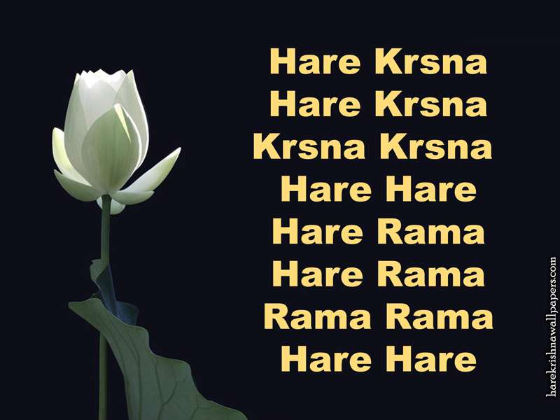
The Mantra

